Slide 1
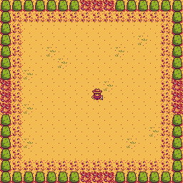
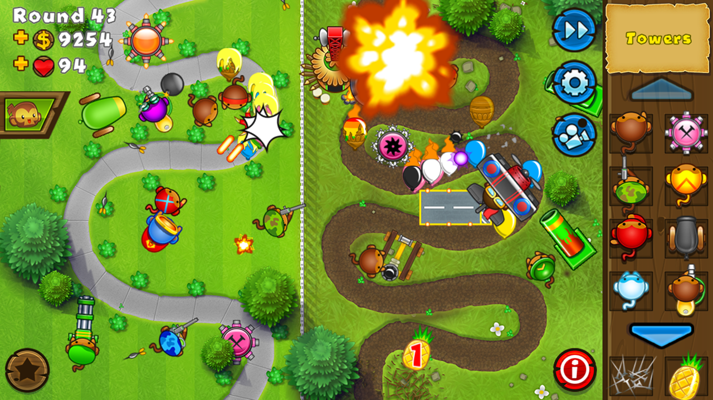
Our Game Idea
Bench Gamers (team name)
The game is a tower defence, like Plants VS Zombies or Bloons TD, except the enemies are set to attack from all around you. You have a tower to defend in the middle of the playing field. Defend by knocking enemies back and building defences against them.
Stardew valley
Bloons Tower Defence
Defences (monkey like)

Slide 2
Visualisation
Bloons Tower Defence
Defences (monkey like)
Stardew valley

Slide 3
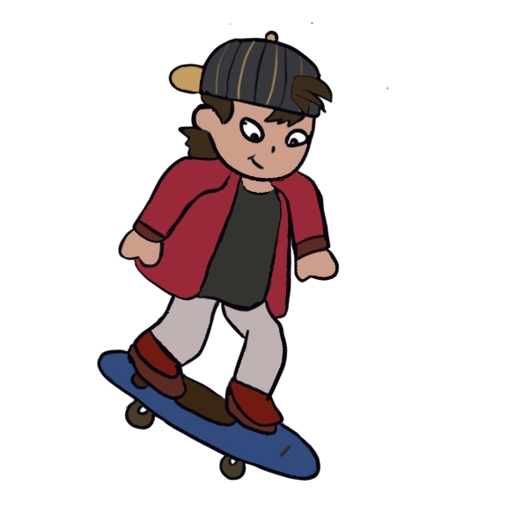
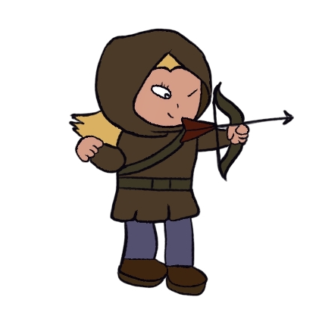
Meaning
The game is made to reflect the state of British politics.
The main character symbolises a rich old man who defends his property from young people who want him to share some of his fortune.
“[britan] is a land of snobbery and privilege, ruled largely by the old and silly” – George Orwell

Slide 4
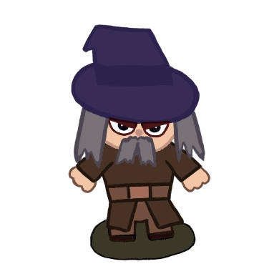
Inspiration
It can be understood similarly to the plot of Shrek for example.
In the film, Shrek doesn’t want to share his swamp with the homeless fairytale characters because he is too used to living a rich life alone. From this we have drawn inspiration for the art style and setting that we will be using drawn by Levi.
<< Main Character (wizard fantasy style)

